Slide 1
WEEK 4
Forms

Slide 2
Feedback in web sites
Web (Fill-in) Forms
Form Elements
Form Delivery
Notes:
Used to create an Interactive environment
Fill-n forms to provide feedback

Slide 3
Feedback in web sites
  Basic concept of the web is information delivery and sharing
  Web documents ‘by default’ are a static mixture of text, images, sound, video…
  Static: once delivered and rendered, the displayed content does not change
  Importantly, there is no mechanism in this for ‘reverse’ information flow: the user sending data to the server
http://www.deakin.edu.au/~atuls/sit104/plantbarn.html

Slide 4
Feedback in web sites
  Why might we want this?
    Providing appropriate personal information
    Requesting specific information
    Providing information for queries and searches
    Ordering goods and/or services

Slide 5
Feedback in web sites
  What does this require?
    extensions to HTML that add input capability
    standardised method of ‘packaging’ input information and sending it to a server
    standardised way for server to handle the data (pass it to a separate program or interpreter for processing, get back output to send back to client)
Fill-in forms
Form method
CGI
Notes:
Form-submitted data needs to be parsed and acted upon
Web server will have a program which accepts the data and parses it.
CGI programs handle the form-submitted data
Action attribute determines where the data needs to go

Slide 6
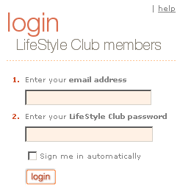
FORMS
A means of collecting information from people who visit your website.
Forms can:
  log you in
  perform a search
  order products
  request information
  conduct market research

Slide 7
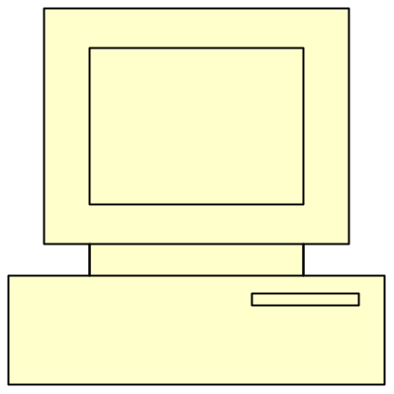

FORMS ALLOW YOU TO ENTER INFORMATION, NOT PROCESS IT.
Common Gateway Interface is a program running on the web server that receives data from the web page and then acts on that data.
Form gets filled-in by client
And processed by a cgi script

Slide 8
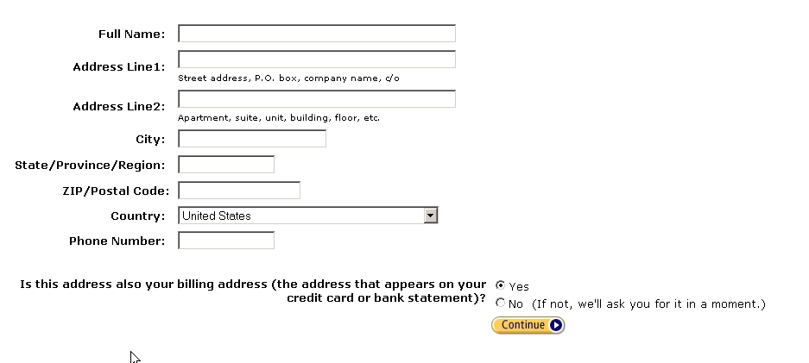
FORM ELEMENTS
Text Box
Selection List
Image Buttons
Radio Buttons

Slide 9
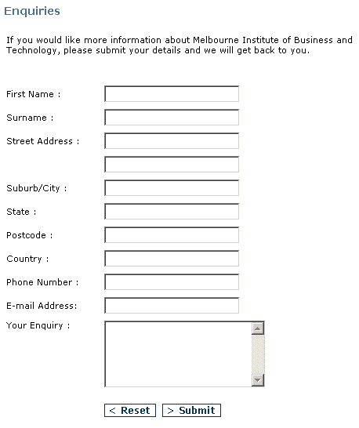
Check Box
Text Area
Submit/Reset buttons

Slide 10
<FORM>
May have a name attribute if web page contains multiple forms
action specifies the URL to which the form is submitted
  <form action=“http://www....”>
method specifies how the form date should be packaged in the request that is sent back to the server
  get
  post
  <form action=“http://www....” method=“post”>

Slide 11
get
  appends the form data to the URL in the request
  form data is separated from the URL in the request by a question mark
http://www.example.com/cgi-bin/search?searchstring=oranges
post
  sends the form data separately

Slide 12
<INPUT>
Enables you to create many different types of form controls
<input attributes />
  type
  name

Slide 13
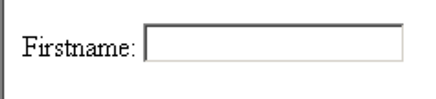
TEXT CONTROLS
<input type=“text” name=“firstname” />

Slide 14

MORE ATTRIBUTES
size – Controls the size of input on the screen
<input type=“text” name=“firstname” size=“50” />

Slide 15

MORE ATTRIBUTES
maxlength – Prevents the user entering more text than required
<input type=“text” name=“displayname” maxlength=“6” />
I want to type superman but it won’t let me

Slide 16

MORE ATTRIBUTES
value – Displays text in the control before the user enters any information
<input type=“text” name=“firstname” value=“Type name here” />

Slide 17

PASSWORD CONTROLS
The data entered is masked so that someone looking at the screen cannot read it.
<input type=“password” name=“userpword” />

Slide 18

CHECK BOXES
Check boxes are either on or off
<input type=“checkbox” name=“updates” />

Slide 19

CHECKED
If you want the box pre “ticked” add the checked attribute.
<input type=“checkbox” name=“updates” checked=“checked” />

Slide 20
GROUPING
Checkboxes can be grouped together and assigned the same name. Only checked boxes will be submitted to the server.

Slide 21
Would you like further information on: <br />
Interior Design <input type="checkbox" name="info" value="id" /><br/>
Recipes <input type="checkbox" name="info" value="recipes" /><br />
Gardening <input type="checkbox" name="info" value="garden" /><br />
Home Maintenance <input type="checkbox" name="info" value="home" />

Slide 22
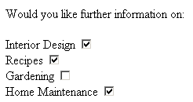
The user has “checked” three checkboxes
This is the information received by the server.
The value tells you what has been selected.

Slide 23
RADIO BUTTONS
Designed so that when one is selected, others in the group are unselected. Only one option can be selected.
checked can be used as an attribute to pre-select an option

Slide 24
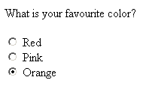
<p>What is your favourite color?</p>
<input type="radio" name="color" value="red" />Red<br />
<input type="radio" name="color" value="pink" />Pink <br />
<input type="radio" name="color" value="orange" /> Orange <br />

Slide 25
SELECTION LIST
Used when there is a fixed set of possible responses.
Guards against spelling errors and erroneous entries.

Slide 26
<p>Which writing short course do you want to enroll in?</p>
<select name="courses">
<option value="101">Romantic novels</option>
<option value="202">Fantasy novels</option>
<option value="303">Science fiction</option>
<option value="404">Crime fiction</option>
<option value="505">Children's novels</option>
<option value="606">Biography/Autobiography</option>
</select>

Slide 27
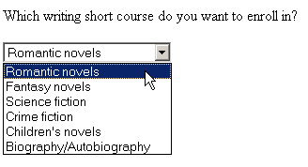
A list with a drop down arrow will appear. The user is going to choose Romantic novels
The value submitted to the server.

Slide 28
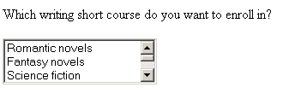
Scrollbars will appear if there are more choices.
You can set a default size for the list with the size attribute:
<select name="courses" size="3">

Slide 29

Choices can be pre-selected
<option value="505" selected="selected">Children's novels</option>

Slide 30
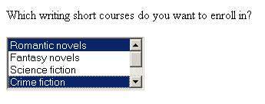
To allow multiple selections, use the multiple attribute. The user holds down Control to make each subsequent selection.
<select name="courses" multiple="multiple">

Slide 31
TEXT AREA
Use the type textarea to greater a larger space for the inclusion of comments from a user.

Slide 32
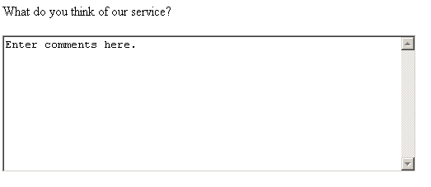
Specifies the size on the screen.
<p>What do you think of our service?</p>
<textarea name="comments" rows="10" cols="60">
Enter comments here.
</textarea>

Slide 33

SUBMIT BUTTON
Required so that the information from the form is sent.
Use the value attribute to change the text on the screen.
Name the button if you have multiple buttons.
<input type="submit“ />
<input type="submit"
value="Finished! Submit me now“ />

Slide 34

RESET BUTTON
Used to set all controls back the their default values.
Can be very annoying if click by mistake.
Use value to change text on button.
<input type="reset" />

Slide 35
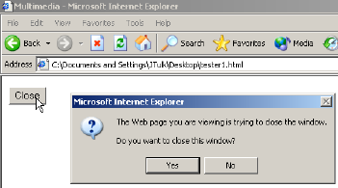
GENERIC BUTTONS
Buttons that have some functionality when combined with a script eg a close button.
<input type="button" value="Close" onClick="javascript:window.close()" />

Slide 36
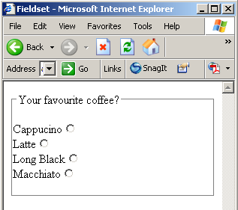
<FIELDSET>
<fieldset>
<legend>Your favourite coffee?</legend><br />
<label>Cappucino<input type="radio" name="capaccino" /></label><br />
<label>Latte<input type="radio" name="latte" /></label><br />
<label>Long Black<input type="radio" name="lb" /></label><br />
<label>Macchiato<input type="radio" name="macc" /></label><br /><br />
</fieldset>

Slide 37
PLANNING
Never underestimate the value of pre-planning prior to development!
  what information do you want to collect
  match each item to a form control
    make the control fit the question
  coordinate with the person writing the script so that variables in the script match names in the form
Test your forms (you can use the action of mailto: for this)

Slide 38
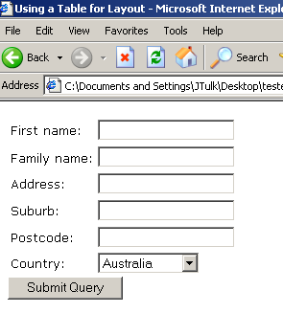
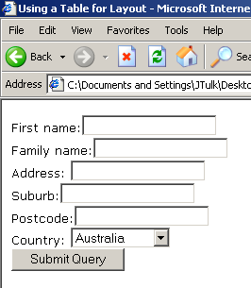
LAYOUT
Use tables to assist with the layout.
Compare this:
To this:

Slide 39
Form Delivery
  As we have seen, the action attribute specifies where the browser is to send the contents of a form
  The method attribute specifies how the contents are to be ‘packaged’ and sent
  As with web documents, form data are sent using HTTP (hypertext transfer protocol)
  As HTTP is a client-server protocol, processing form data is managed through a web server

Slide 40
Form Delivery
  But …
  The server program itself cannot arbitrarily extend its functionality to support form processing
  So the actual processing must be done by a separate program (or script) with which the server program interacts
  How this interaction is to work must be standardised
  Such a standard exists: the Common Gateway Interface (CGI)

Slide 41
Common Gateway Interface
  We need to be able to:
    make the form data accessible to the processing program
    decode the form data (name+value pairs, and any files in a multi-part form)
    store the data if required (database and/or file access)
    generate output files, including HTML-formatted documents to send back to the client – in real time
    make these newly-created pages accessible to the server, so they can be sent back to the client

Slide 42
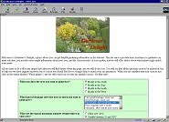
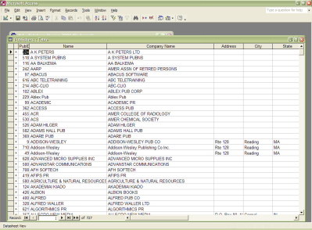
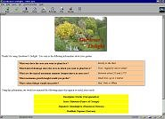
CGI Example:
CGI script
queries
database
Form sent
to CGI
Server
+ CGI
Output page
generated
User fills
in form

Slide 43
Common Gateway Interface
      most widely-used CGI scripting language has been Perl (Practical Extraction and Report Language), developed in 1986 by Larry Wall
      strong on text file processing (based on ability to handle files as single strings, and powerful pattern matching operations)
      weaker on database access
      highly portable; most scripts will run on different platforms with only one or two lines changed

Slide 44
Common Gateway Interface
    similar syntax to C and Unix shell utilities (sed, sh, awk)
    requires a Perl interpreter and a cgi library (for form decoding and ‘automated’ HTML generation)
PHP
    developed to enhance web pages, but can be used in a CGI environment to
      access external data sources (databases)
      generate dynamic, formatted output

